Slide 1
Digital Gift Card: Product Ideation & Modality
January, 2024

Slide 2

Prologue
How was your last gifting experience ?
- Good/Bad/Quite Good ?
- What if we make it even Better?

Slide 3
Current Scenario
2 types of Gift Card: Open Loop & Closed Loop Gift card
Mostly Used in Festive season and Special Occasion
Gift Card Industry : Early stage of development
Open loop gift cards are offered by Financial Institutions only

Slide 4
Current Scenario
Increasing Popularity of
e-commerce & online shopping
Growing Demand for convenient and flexible payment option
Rising Disposable Income
Targeted Audience: Young People aged over 18
Changing technology trends made gift card more popular

Slide 5

Current Scenario
Genre Of Gift Card
Retail Gift Card
Restaurant Gift Card
Entertainment Gift Card
Travel Gift Card
Digital Gift Card
Gift Card
Most Popular Type: Retail Gift card

Slide 6




Key Insights
Restraints
Opportunities
Drivers
Challenges
1. Low Literary rate
2. Digital Awareness
3. Trust and reliability
4. Brick and Mortar habit
Increasing demand of non cash transaction
Allows opportunity to nor card holders
Gen Z trend
Social Trend
Discounted Price
Wide Acceptance
Usability
Competition from traditional method
Cash Based Culture

Slide 7
In a nutshell
Widely accepted gift card has more utility
People want to buy gift card to enjoy reward/incentives
Low literacy and lack of awareness are major barrier of gift card
Gift cards are Gen Z trends
&
tech adoption of this segment high
Acceptance of Digital Gift card will be higher

Slide 8
Situation Analysis
Fashion & Lifestyle brands
1. BATA
2. Apex
3.Aarong
4.Infinity
5.Sailor
6.Artisan
7.TOP10 Mart
8. Men’s World
9. Gentle Park
Financial Institutions
1.MTB
2.DBBL
3.EXIM
4.SIB PLC
5.City Bank
6.Dhaka Bank
Financial Institutions & NPS organisations
Available Organisations in Bangladesh

Slide 9
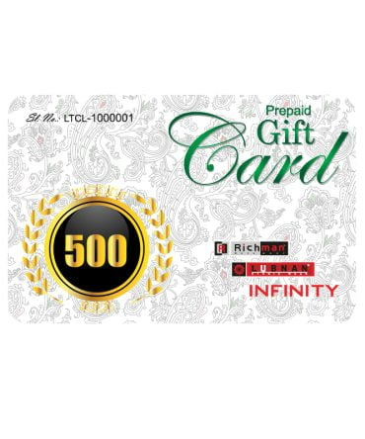

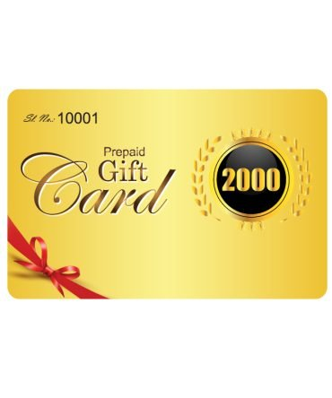
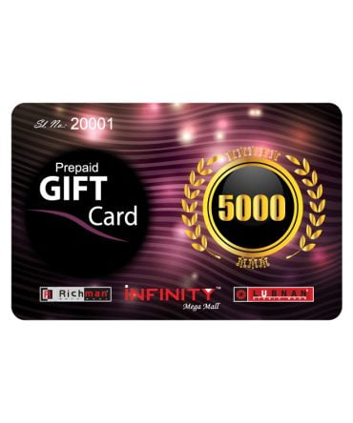
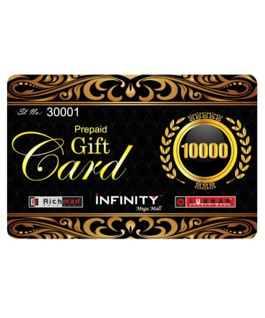
Infinity (Richman)
Modality
Infinity promotes the uniqueness in each customers that’s why they encourage gifting cards to beloved one to enable their respective choice
Suitable Denomination | TK 500 TK 1000 TK 2000 TK5000 TK 1000
Validity | 6 Months from the day of purchase
Transaction Case | 1 Time Purchase
Usage | All Outlets & all products

Slide 10
Bata
Modality
Suitable Denomination | TK 2000, TK 3000, TK 5000, TK 10000, TK 15000
Incentives | 25% Cash Back, Special CB up to TK 150, (Daily TK 100)
Validity | 1 Month starting from the date of purchase
Activation | 24 working hours
Bata believes in empowering unique style & their gift cards make style affordable

Slide 11

Apex
Modality
Suitable Denomination | TK 2500, TK 5000 TK 7500 TK 10000 TK 15000 TK 20000
Incentives | Up to 25% off
Validity | 60 days from the day of issue
Activation | Within 48 hours of payment made
Neither exchangeable nor refundable, replaceable, or transferable.
Single redemption for single invoice.

Slide 12
Aarong
Modality
Suitable Denomination | TK1000,TK2000,TK3000,TK5000
Transaction Case | Applicable for single transaction only
Validity | 1 year
Exchangeability and Replacement | Not exchangeable & replaceable
Aarong loves to help people decoring their house and lifestyle, Aarong Gift Cards to spread the energy of decoring your home in your way

Slide 13
Sailor
Modality
Suitable Denomination | TK1500 TK 2000 TK 3000 TK 5000 TK 10000
Transaction Case | 1 voucher for 1 invoice/ transaction
Validity | 60 days from the day of purchase
Activation Time | 48 hours (Non-Refundable)
Refund-ability | Non-Refundable and one time redemption
Gifting apparel may cause choice and size issue, rather gifting certain value elevates the love & care of valuing others choice

Slide 14

Artisan
Modality
Suitable Denomination | TK 1000, TK 2000, TK 5000, TK 10000
Transaction Case | 1 Voucher for 1 transaction only
Validity | 2 months from the day of activation
Activation Time | 48 hours
Availability | Artisan Website only
Regular price will be charged on Gift card
Won’t be eligible in Accessories

Slide 15

Top Ten Mart
Modality
Types of Gift Card | Digital & Physical
Suitable Denomination | Digital: TK 500 TK 1000 TK 2000 TK 3000 TK 4000 TK 5000 TK 10000 Physical: TK 1000 TK 5000
Validity: | 6 month from the day of purchase
Incentives: | 10% on both case
Activation: | 48 hours
No Outstanding Balance
One time redemption

Slide 16
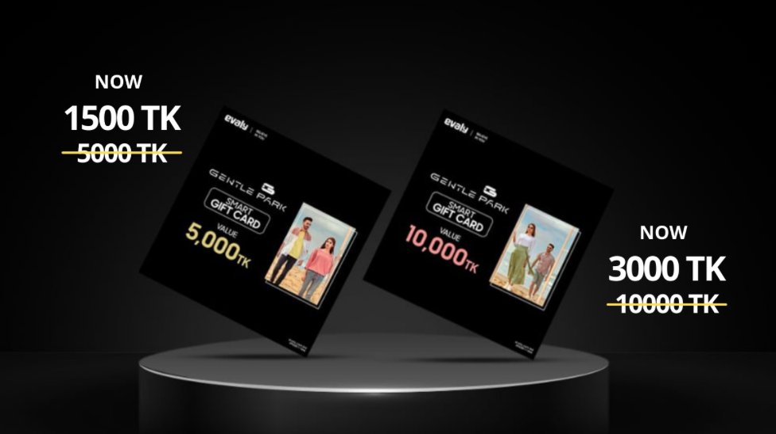
Gentle Park
Modality
Suitable Denomination | 5000 and 1000 only
Incentives | minimum 20% discount
Activation | 21 days from the date of issue
Validity | 45 days from the date of issue
Can’t be Exchanged
One time redemption

Slide 17

Men’s World
Modality
Suitable Denomination | TK2000 TK3000 TK5000 TK10000
Incentive | 15% to 20%
Activation | Within 3-5hours after purchase
Validity | 1 month from the day of purchase
Allowed to buy Discounted, MRP, offer and regular products
Any number of product in one invoice

Slide 18
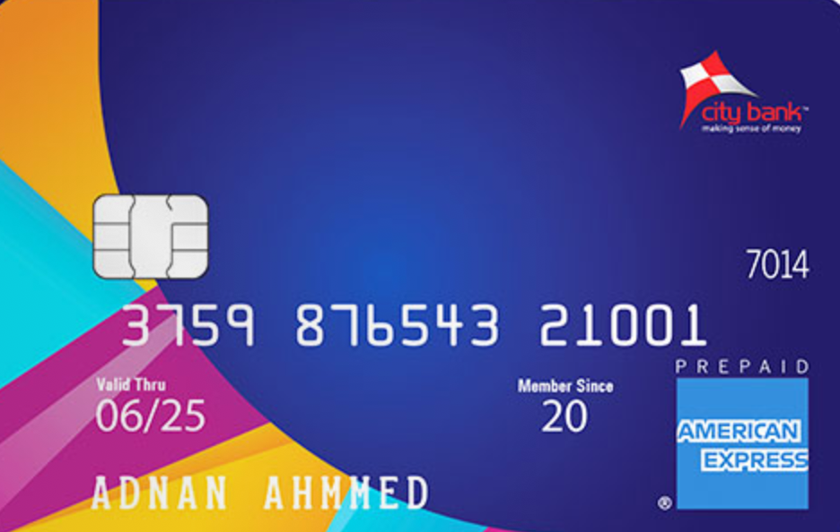
City Bank
Modality
Max ATM withdrawal | TK 20,000
Expire Date | Unlimited Time
Fee | Issuance Fee:500 ; Mark-up Fee 2.5% Card Replacement Fee 500/-
Card Limit | Monthly: (TK 1,00,000 &Transaction Count: 40) Daily: (BDT 50,000 & 10 times)
FREQUENCY OF RELOAD | Monthly 05
City Bank AMEX Gift card

Slide 19
Dhaka Bank
Modality
Encashment rate | Within 3 month – Nil After 3 months – 3%
Expire Date | Unlimited Time
Refund Option | May be ( if lost or stolen )
Suitable Denomination | TK 100, TK 500, TK 1000 & TK 5000
Gift Cheque
No service charge, Unlimited usability

Slide 20
MTB
Modality
MTB Gift Card
Expire Date | Unlimited Time
Reload and limitation | Non-reloadable prepaid card
Suitable Denomination | TK 2000, TK 3000, TK 5000 & TK 10000
USP | Simple Application Process, can be used for POS, and Online transactions within Bangladesh
Useable only on POS & Online transaction

Slide 21
DBBL
Modality
Interest rate | N/A
Expire Date | 1 year
Reload Option | Available (from NexusPay/ Cash/ Cheque/ Debit Instruction/ ATM/ IB)
Minimum Limit | TK 5000
Targeted Segment | 18 and above
FCY Endorsement | available (based on user profile)
Nexus Digital Gift Card
Reimbursable
Replaceable
No Additional Fees

Slide 22
SIB PLC
Modality
Issuance Fee | For General 400/- Reissuance Fee 300BDT
USP | Shariah based, ATM,POS, e-commerce transaction facility. easy to get back the unutilized money
Cash Load Option | One time (no loading fee)
ATM Transaction | BDT 50,000/- Max (Volume 20,000/-, Count 25 times)
POS Transaction | Single transaction BDT50,000; count 10 times
SIB
EMV based card, No Loading Fee, No hidden Charge

Slide 23
EXIM Bank
Modality
Issuance Fee | BDT 500 + 15%VAT
Expire Date | 5 Years ( renewable for every year)
USP | Pre-personalized Card within 24 hours Doesn’t require bank account
Limit | Loading unlimited money
Flexibility | Cash withdrawal from any EXIM, Q-Cash or VISA branded ATM booths,
EXIM GIFT CARD
Works as visa local card

Slide 24
International Landscape: Amazon
Modality
Issuance Fee | No Issuance fees,
Expire Date | No expiry fees,
USP | Redeemable towards millions of items, immediate delivery
Limitation | No refund or return, not useable in any overseas amazon website.
Flexibility | Deliverable through email or text
Cash Limit | USD 25 To USD 2000
e-GIFT CARD
Animated e-Gift card
Amazon Digital Gift card

Slide 25
International Landscape: Flipkart
Modality
Issuance Fee | No issuance fees
Expire Date | 12 months from purchase
USP | Can be redeemed 15 gift cards in a single purchase
Limit | Rs25 to Rs10,000 (max purchase volume Rs100000/month
Flexibility | Outstanding Balance can be used for subsequent transactions
Generic Gift Card
Digital Gift Card
Flipkart Digital Gift Card

Slide 26
International Landscape: PayPal
Modality
Issuance Fee | Popular Gift Card, Brand Gift Card, Travel & Leisure, Sports and Outdoor
Redemption | Selected Stores/ merchants only. Can’t be redeem for cash.
USP | Can be redeemed both in physical and online stores of Brands
Limit | Minimum amount $25, Service/Brand specific gift card.
Generic Gift Card
Digital Gift Card
Paypal Digital Gift Card

Slide 27
Customer’s Pain Point
Process Pain Point:
1. Takes paperwork and documentation
2. Requires multiple platform to complete purchase
Productivity Pain Point:
1. Financial Gift Cards are Non reloadable & there is an expiry limit
2. Retail Gift cards have limited validity & these are useable on specific stores only.
Financial Pain Point:
1. Higher Issuance fees
2. Transaction count and amount limitation
Process Pain Point
Financial Pain Point
Productivity Pain Point

Slide 28



Problem Statement
Higher Fees
Issuance/reissuance Charges are very high.
Requires encashment fees
Flexibility
Validity Issue
Rigid Ceiling & threshold of purchase amount
High activation time & fixed redemption
Procedure
No easy way of purchase
Physical Presence & paperwork requires
Limited Usability
Customers find it inconvenient and lengthy procedure to purchase financial gift card at the same time retail cards have limited usability.

Slide 29

Market Gap: Unmet Needs
Versatile Validity based on multiple modality
A wide range of choice for customers
Financial Needs
Validity Needs
Premium Value with VAS
High Value
Mid value with max validity
Low value with short term Validity
Customers want versatility in selecting amount and wide acceptance of their purchased card/voucher

Slide 30

Market Gap: Impact
Wide Acceptance
Flexibility of determining how much to pay.
Usability of Outstanding Balance
Flexibility & Utility
Let’s leave How, When & How much to pay on customers

Slide 31
Business Opportunity
Close Loop
Flexibility
Validity
Outstanding Balance
Convenience
Utility
Business Gap
bKash Gift Card
Open Loop
Financial Gift cards are high value, retail gift cards are affordable but these have validity and acceptance issues
Customers feel deprived of gift cards that have low to moderate value with higher validity and wide acceptance

Slide 32
Modality & Business Scope
Issuance Fee | No fees
Expire Date | 7days, 15days, 30days, 45days, 60days, 90days up to 1 year
USP | Country wide Acceptance, No Paperwork, Validity extendibility, In App Purchase Solution
Limitation | No refund or return, no Cash Out or Send Money with gift card
Flexibility | Can redeem any amount within eligible duration, usable outstanding balance,1 encashment
Cash Limit | From BDT 300 to BDT 30000 (Flexible)
bKash Gift Card with Fixed and Personalised Modality
bKash customers will choose ready to go fixed Modality gift card or High Value personalised cards

Slide 33
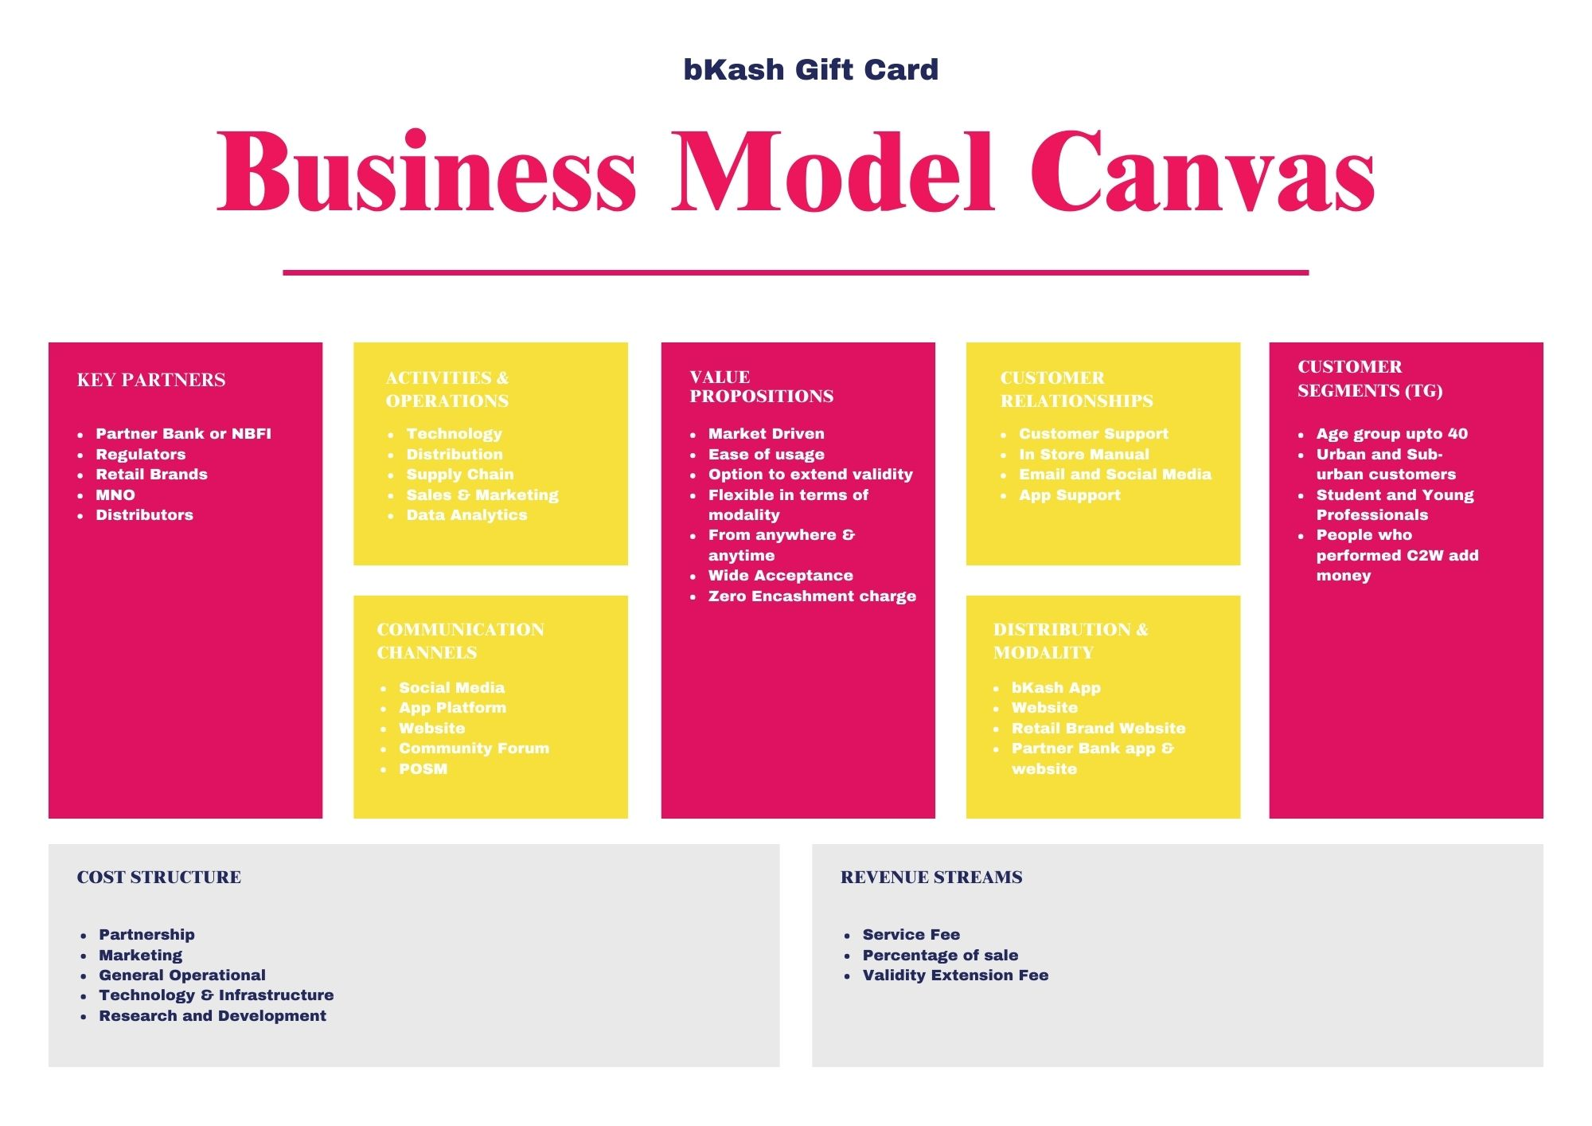
Business Model: Gift Card/Voucher
A customer centric financial product that has ample flexibility for users and wide acceptance across Bangladesh, earns revenue through service fee, sales commission & validity extension fees

Slide 34
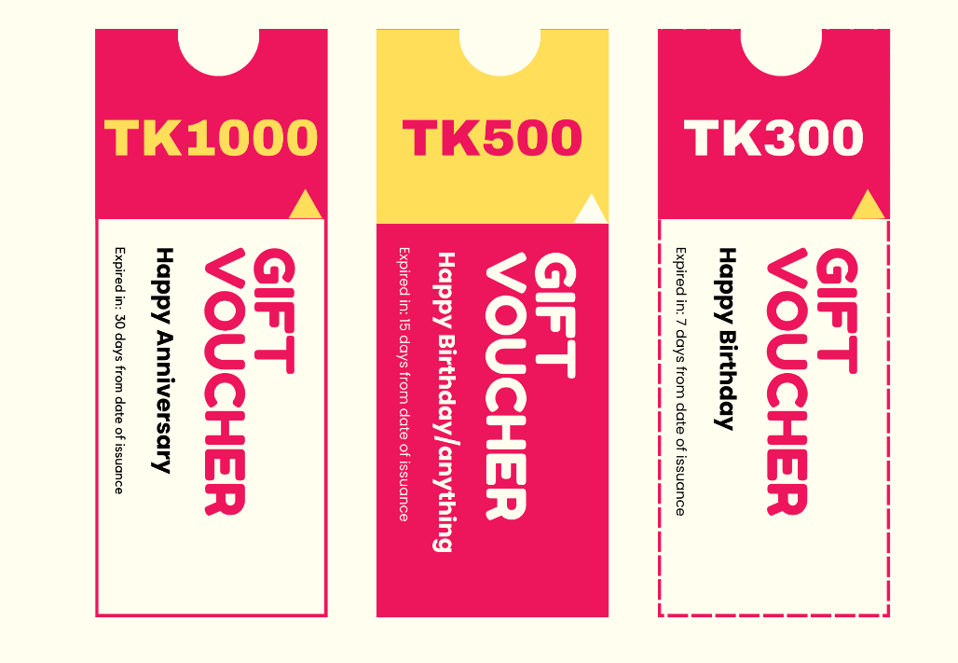
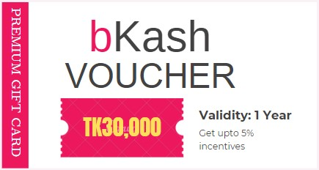
Value Proposition
Get Your State-of-the-art Gifting Experience
Gifting your loved ones or yourself is now easy, flexible, convenient and dynamic. So, gift the way you like.
Low Value Voucher
Premium Voucher

Slide 35
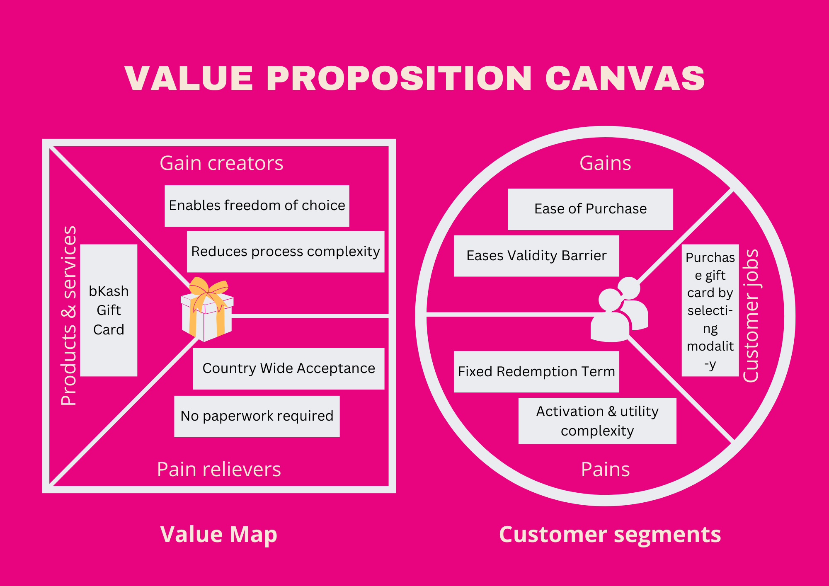
Value Proposition Canvas
Value Map:
Gain Creator: bKash gift card will provide a simplified process and variety of choices
Pain Reliever: customer can purchase financial gift card from any where and redeem it everywhere
Product & Service: bKash gift card simplifies customers gifting journey with zero paperwork
Customer Profile:
Customer Jobs: Customers need to purchase their desired gift card by choosing modality.
Gain: Customers can enjoy one stop solution and validity is more flexible
Pain: Customers face difficulties in redeeming cards, traditional cards have limited utility and one time redemption

Slide 36

Probable Solution: bKash Gift Card
Modality:
Validity-7,10,15,30,45,60,90,360 days
Amount- BDT 300,500,1000,1500,2000,2500,3000,3500,5000 up to 30000
Suggested Name: b-Joy, Happiness Bite, e-nvelope
C
Acceptance & Validity:
1. all brand shop & superstore across Bangladesh
2. Validity can be extended up to one year
Distribution: 1. bKash app
2. bKash Website
3. Agent & Merchant point

Slide 37
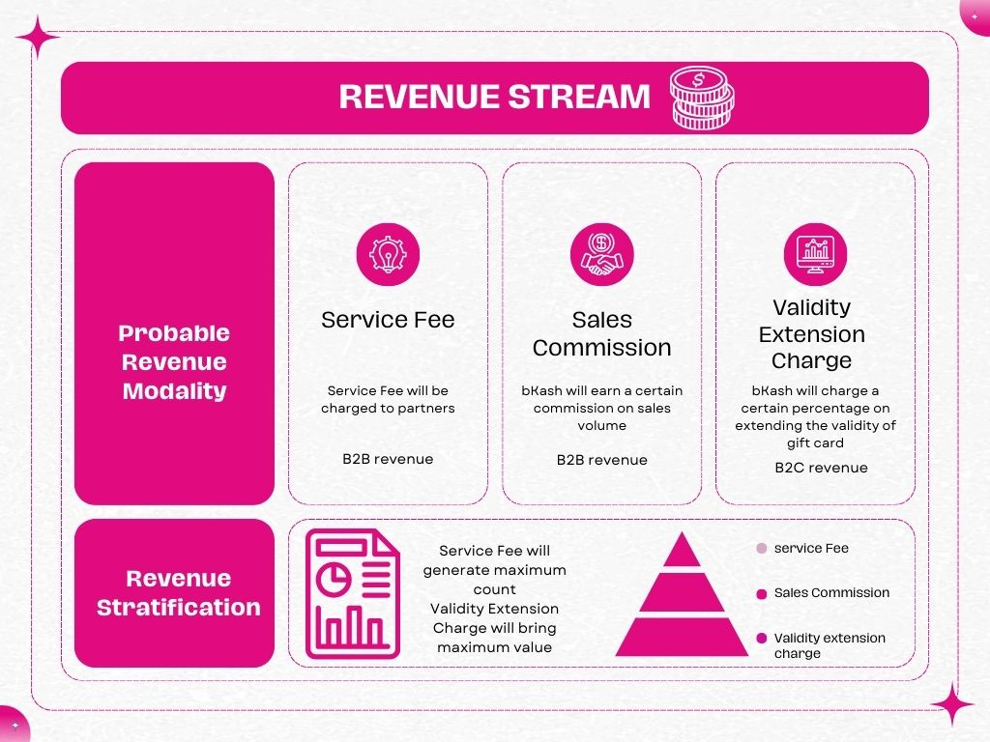
Revenue Stream:
Validity Extension Charge will be the primary source of revenue
Service Fees and Sales commission - low value high count revenue generator

Slide 38



Key Drivers and Market Size
Expected to grow at a rate of 12.5% from 2033
Total market size was 310.1 Billion
By the end of 2032, market size is expected to reach 1.2 Trillion
acceptance of digital payments
e-commerce dominance
Customisation and personalisation
Shifting consumer preferences
International Trends
International Perspective

Slide 39
Thank You

